Slide 1
A Comprehensive Investigation of Traffic Accidents in UK through Statistical methods, ML algorithms, and Deep learning
Md Asif mahmod Tusher Siddique
Supervisor: Dr. Ah-Lian kor

Slide 2
Table of contents
Introduction
Research goals
Literature review
Methodology
Results and discussion
Summary

Slide 3
Introduction
Traffic casualties are a significant concern for modern civilization since its responsible for fatalities, emissions, and financial damage
About 1.35 million individuals worldwide perish every annum as a consequence of road casualties (WHO, 2018)
From 2012 to 2019, 1,850 traffic fatalities every year, around 5 on each day in England (Brake, 2020)
Even during pandemic 1,460 traffic fatalities and 23,529 killed or seriously injured (National statistics, 2021).

Slide 4
Research goals
To analyse road accidents in UK from 2016 till 2021
To perform a comprehensive literature review on the road accidents
To find proper dataset to do the analysis
To perform 4 levels of Descriptive, inferential, Machine learning, and Deep learning analysis
Compare the results obtained from ML and DL models

Slide 5
Literature review
Haddon and William (1980) identified risk variables in connection to the person, vehicle, and road infrastructure before, during, and after the incident.
Al-Balbissi (2003), worked on the influence of sex on the traffic casualties, which included surrounding environmental situations and the age of the driver.
Casselgren and Bodin (2017) states that, road fatalities are more plausible to occur on increased-speed routes as well as highways, but not amid congestions
As per Qiao and Shang (2011), mean speed of running, maximal and median degree of straight bends, quantity of upright bends, nature of road surface, period of day, and quantity of cars per hour are perhaps the most cogent determinants to traffic casualties in precarious places.

Slide 6
Literature review
Clustering techniques were utilized to discover high-accident locations, next utilized frequent patterns to find characteristics that influence road incidents in that place by Kumar and Toshniwal (2016).
Time series analysis utilized by Ljubič et al. (2002) to study the road accidents in UK
Hypothesis testing employed by Sikdar et al. (2017) to analyse accidents that occurred in India.
A BP neural network employed by (Ming and Xiucheng, 2009) to investigate the association among incidence assessing score and potential accident numbers

Slide 7
Methodology
Macro level analysis of data pre-processing techniques such as KDD, SEMMA, CRISP-DM.
Descriptive data analysis on different features of the dataset.
T-test, ANOVA, and Pearson’s correlation test is utilised to find correlations between severity and other features.
For Machine learning, algorithms such as Decision tree, Logistic regression, Random forest is used.
For deep learning, classification algorithms such as CNN, LSTM, and GRU is utilised.

Slide 8
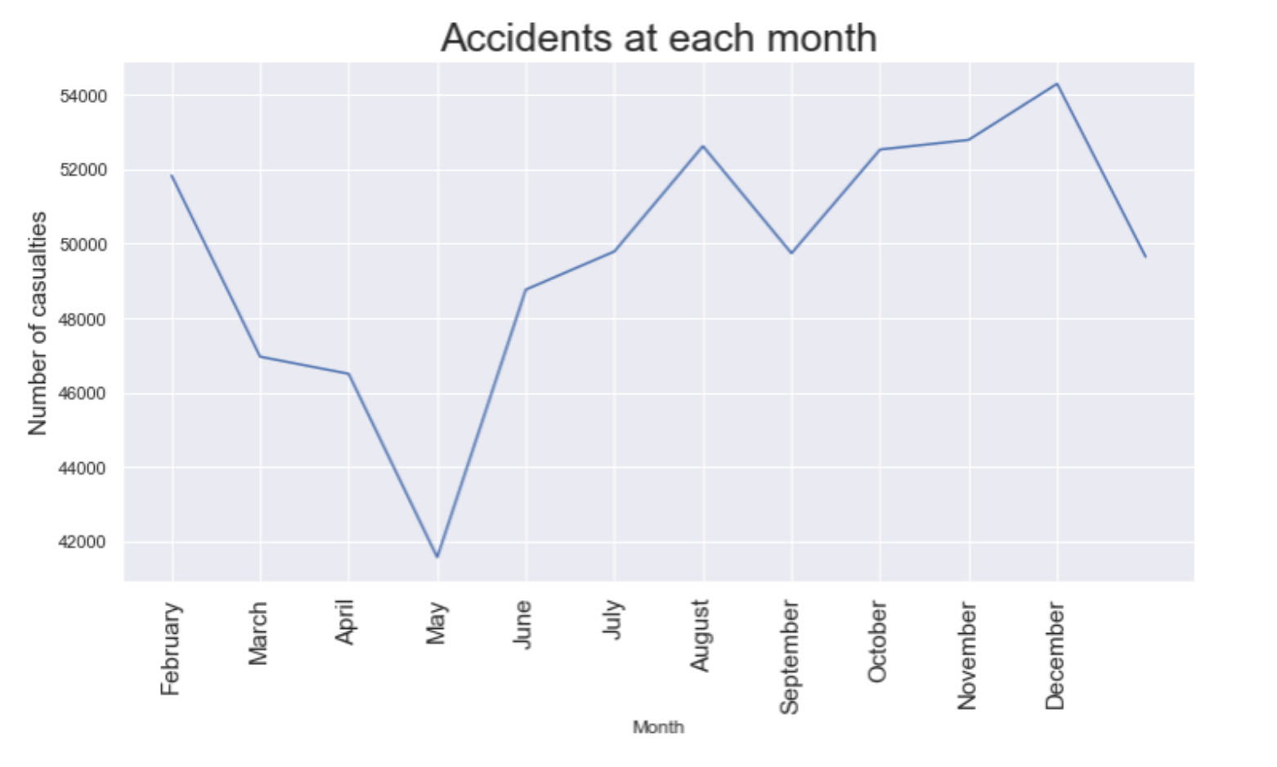
Descriptive statistical analysis

Slide 9
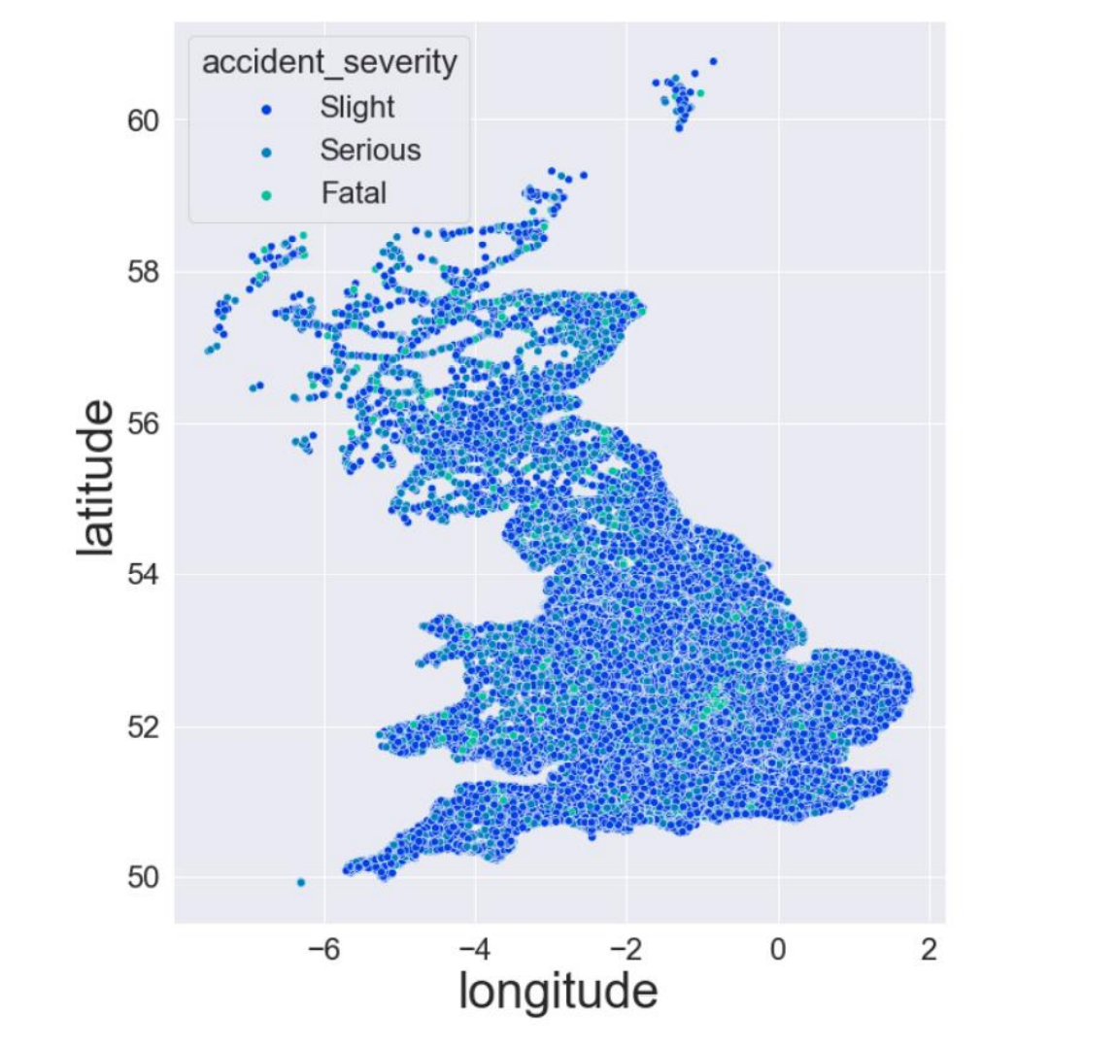
Descriptive statistical analysis

Slide 10
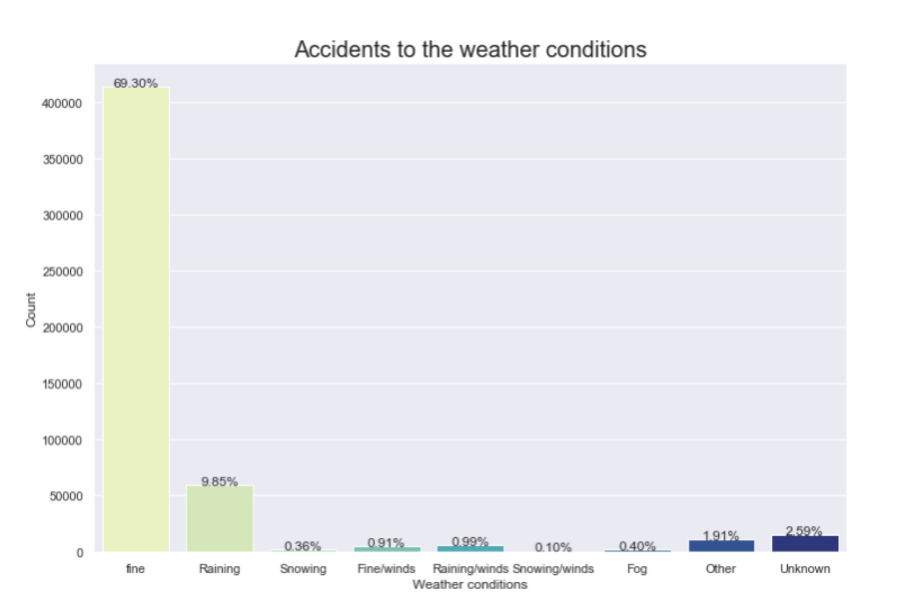
Descriptive statistical analysis

Slide 11
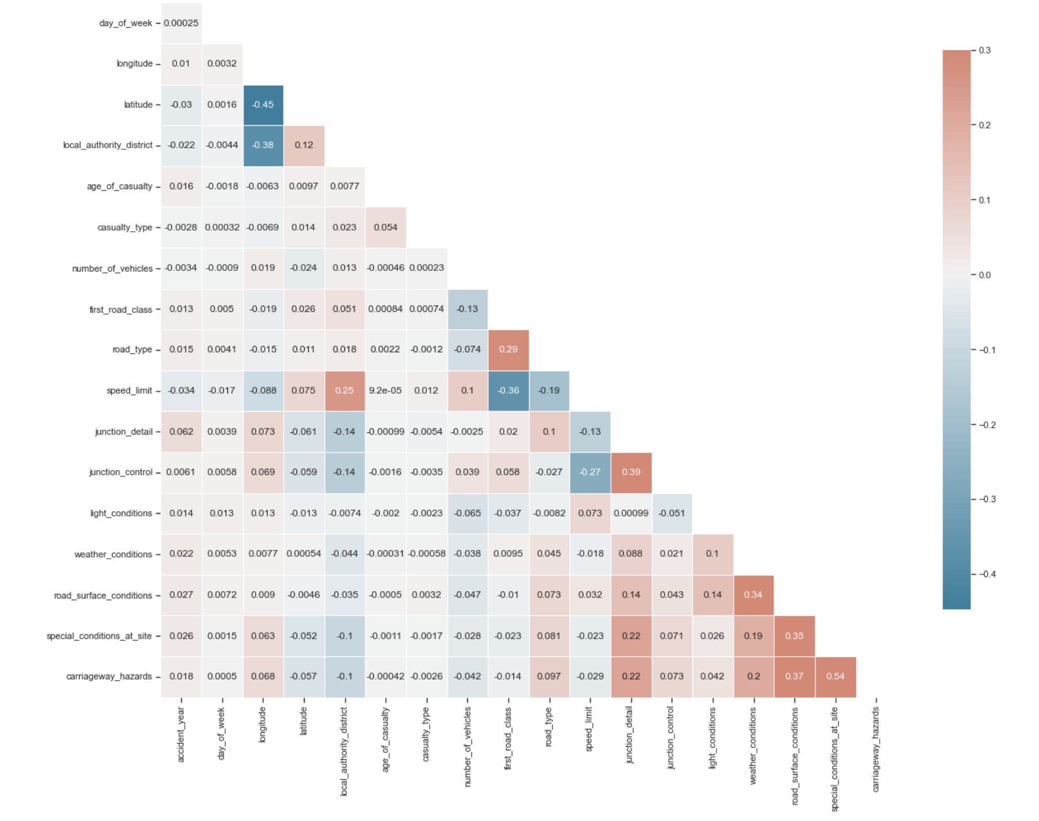
Correlation

Slide 12
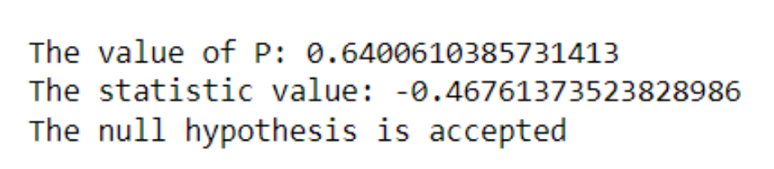
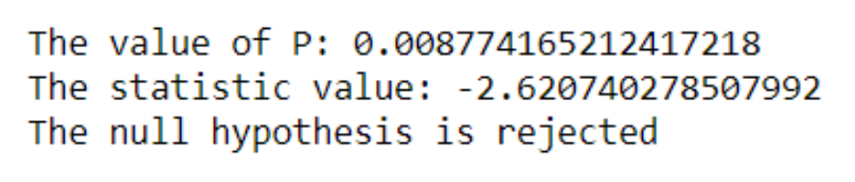
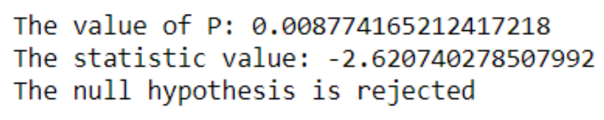
T-test results
Accident severity – Gender of the driver
Accident severity – Lighting conditions
Accident severity – Drivers age

Slide 13
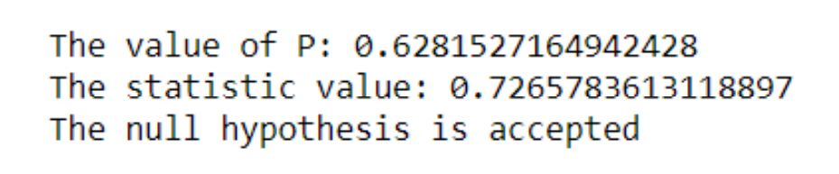
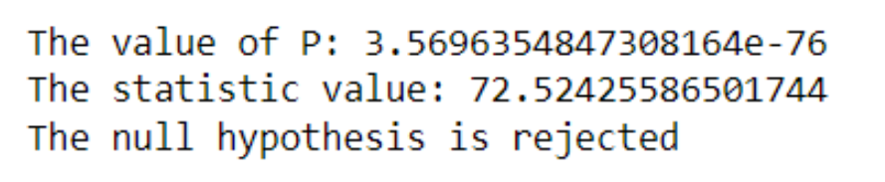
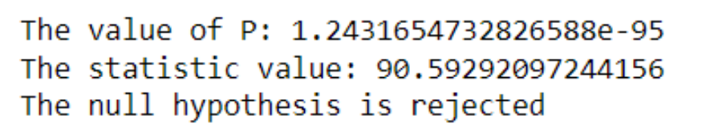
ANOVA results
Casualty type – Day of the week
Accident severity – Road class
Accident severity – Road Surface conditions

Slide 14
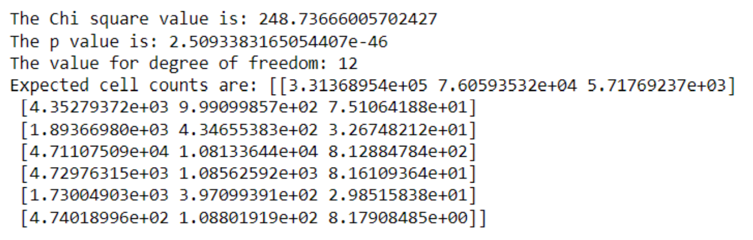
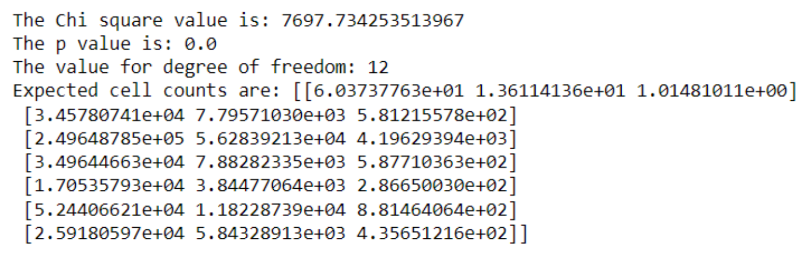
Chi-square test of independence results
Accident severity – Weather conditions
Accident severity – Speed limits

Slide 15
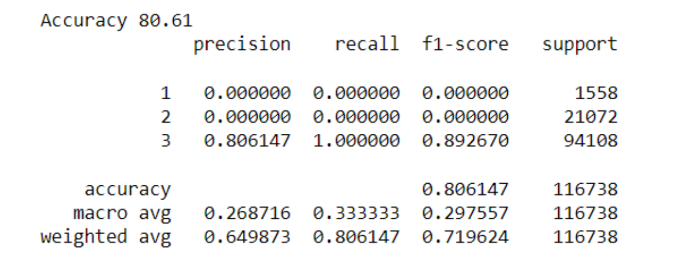
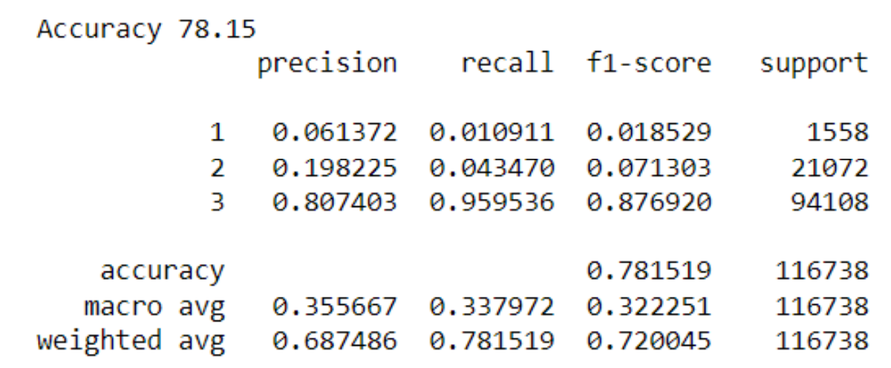
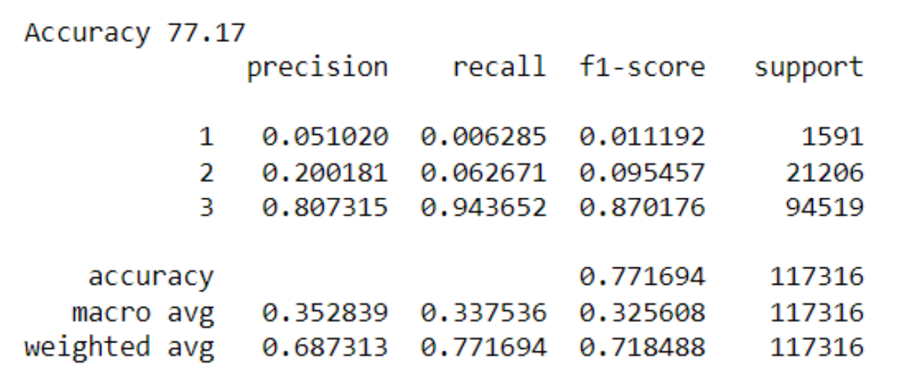
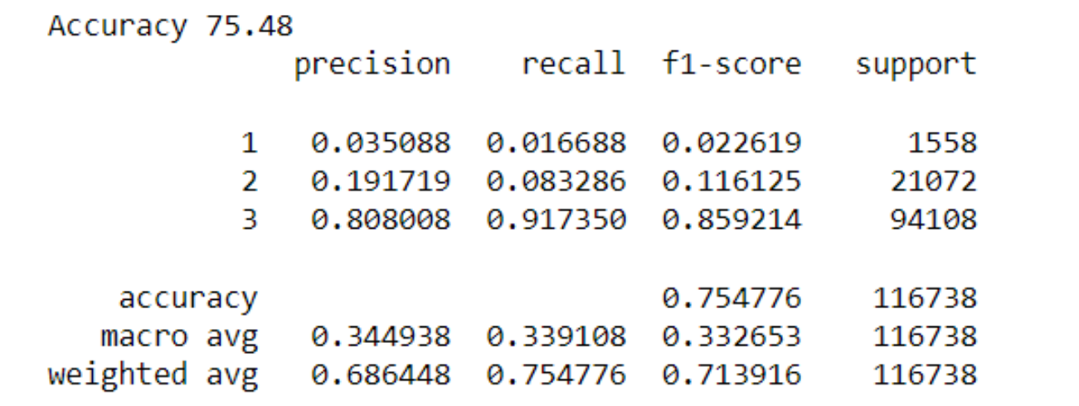
Machine learning models
Logistic regression
Random forest
KNN
Decision Tree

Slide 16
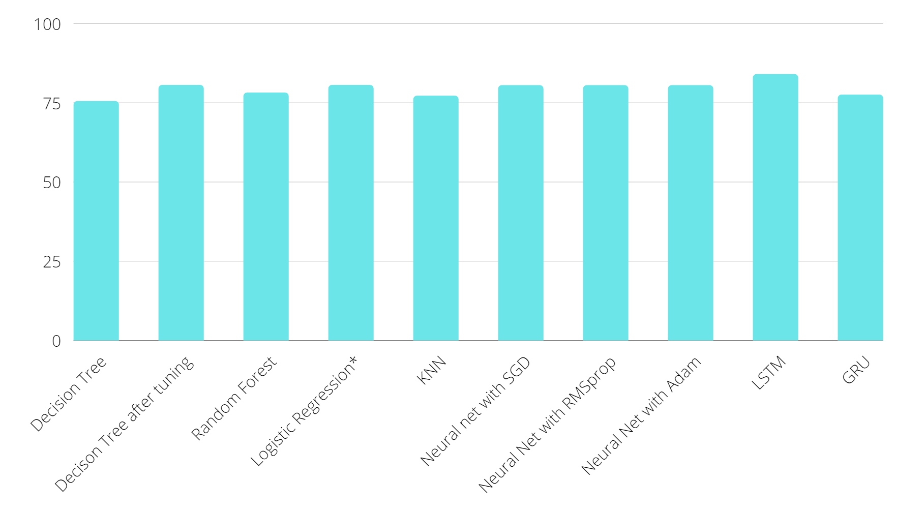
Algorithms result analysis

Slide 17
Conclusion
From Statistical testing we found the age, gender, and area type are important contributors to road accidents
Among Machine learning algorithms Decision tree performed the best.
Among Deep learning algorithms LSTM performed the best.
Hyperparameter tuning had no effect in simple neural network.

Slide 18
Thank You

Slide 19
References
WHO, 2018, Global status report on road safety. Available at: https://www.who.int/newsroom/fact-sheets/detail/road-traffic-injuries. (Accessed: 18th April 2022)
Brake: the road safety charity, 2020, UK road death and casualty statistics, Available at https://www.brake.org.uk/get-involved/take-action/mybrake/knowledge-centre/uk-roadsafety. (Accessed: 18th April 2022)
National statistics, 25 November 2021, Reported Road casualties in Great Britain, provisional estimates: year ending June 2021.
Haddon Jr, W., 1980. Advances in the epidemiology of injuries as a basis for public policy. Public health reports, 95(5), p.411.
Al-Balbissi, A.H., 2003. Role of gender in road accidents. Traffic injury prevention, 4(1), pp.64-73.
Ming, H. and Xiucheng, G., 2009, October. The application of bp neural network principal component analysis in the forecasting the road traffic accident. In 2009 Second International Conference on Intelligent Computation Technology and Automation (Vol. 1, pp. 107-111). IEEE

Slide 20
References
Casselgren, J. and Bodin, U., 2017. Reusable road condition information system for traffic safety and targeted maintenance. IET Intelligent Transport Systems, 11(4), pp.230-238.
Qiao, W. and Shang, B., 2011, June. Current situation analysis and safety countermeasure study on road traffic accidents in China. In 2011 International Conference on Remote Sensing, Environment and Transportation Engineering (pp. 3034-3037). IEEE.
Ljubič, P., Todorovski, L., Lavrač, N. and Bullas, J.C., 2002. Time-series analysis of UK traffic accident data. In Proceedings of the Fifth International Multi-Conference Information Society (pp. 131-134).
Kumar, S. and Toshniwal, D., 2016. A data mining approach to characterize road accident locations. Journal of Modern Transportation, 24(1), pp.62-72.
Sikdar, P., Rabbani, A., Dhapekar, N.K. and Bhatt, D.G., 2017. Hypothesis testing of road traffic accident data in india. International Journal of Civil Engineering and Technology (IJCIET), 8(6), pp.430-435.

